Slide 1
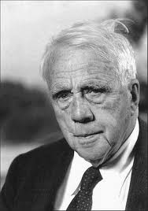
Robert Frost

Slide 2
Robert Frost
Born March 26, 1874 in San Francisco
Father was journalist
Mother was a teacher
Named after Robert E. Lee (famous Southern general)
Notes:
Robert’s father was from the South so admired the general.

Slide 3
Childhood
Father died when he was 11
Robert, his mother, and sister went to live with his grandfather in Massachusetts
Took a job as a cobbler to help pay the rent
Grandfather paid for him to attend Lawrence High School where he was the top of his class.
Notes:
His job as a cobbler had him nailing heels to boots.

Slide 4
Teenager
At 16, Frost began to write poetry
Jotted down words that seemed to just come into his mind.
However, he was still not thinking of becoming a poet for a job.

Slide 5
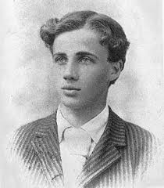
College Guy?
After he graduated, he wasn’t interested in college!
He was interested in poetry.
Like to wander through the woods reading a collection of poetry.
At age 19, sent his first poem to a
magazine called The Independent

Slide 6
The Working World
He needed income
Tried being a journalist
Didn’t like getting into things that were not his business
Taught school with mother and sister
Didn’t like teaching young children

Slide 7
Marriage
1895 Married Elinor White
She was the other top student in his H.S. class
Had son Eliot

Slide 8
Back to work again
Wanted to be a college professor but hadn’t gone to college himself
Grandfather helped pay for him to go to Harvard
Classes bored him
Eliot got sick and died
Left without finishing

Slide 9
Still needed money
Grandfather would pay for a farm if Frost would be a farmer
1900 Frost, Elinor, and new baby daughter went to Derry, New Hampshire
Dairy farm
Chores during day
Wrote poems at night
“Mending Wall”
“October”

Slide 10
Still no money
Had 3 more children
Director of Pinkerton Academy offered Frost a job
Teaching English class 2 days a week
Frost took the job
Continued to farm also

Slide 11
Change again?!?!
Sold the farm after 10 years
Didn’t like the schedule
Had hay fever
Even though poems had been rejected, he knew he had to keep trying
Decided to go to England

Slide 12
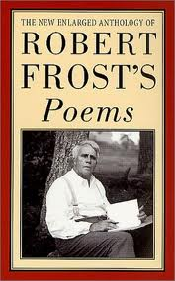
Success!
Took 30 poems to London publisher
Three days later, they were accepted for a book
He began his professional career as a poet
1913 “A Boy’s Will”
1914 “North of Boston”
Books reprinted in America
“My books have gone home; we must go too.”

Slide 13
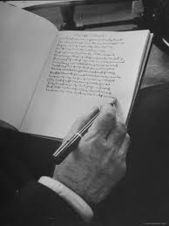
Being a Poet
Frost looked around him for inspiration
Walked pastures
“The Vantage Point”
Explored Forests
“The Road Not Taken”
Watched cows
“The Cow in Apple Time”
Saw boys climbing trees
“Birches”

Slide 14
Teaching
Frost asked to teach at colleges
Helped start a college- Bread Loaf School of English in Vermont
Challenging, witty, grouchy teacher
Once threw a whole pile of compositions away
Kids loved him- HE MADE THEM THINK!!

Slide 15
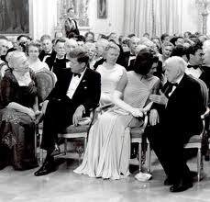
Honors
1923 published “New Hampshire”
Won Pulitzer Prize
Won 3 more Pulitzer prizes
Became the country’s most beloved poet
Read “The Gift Outright” at President JFK’s inauguration

Slide 16
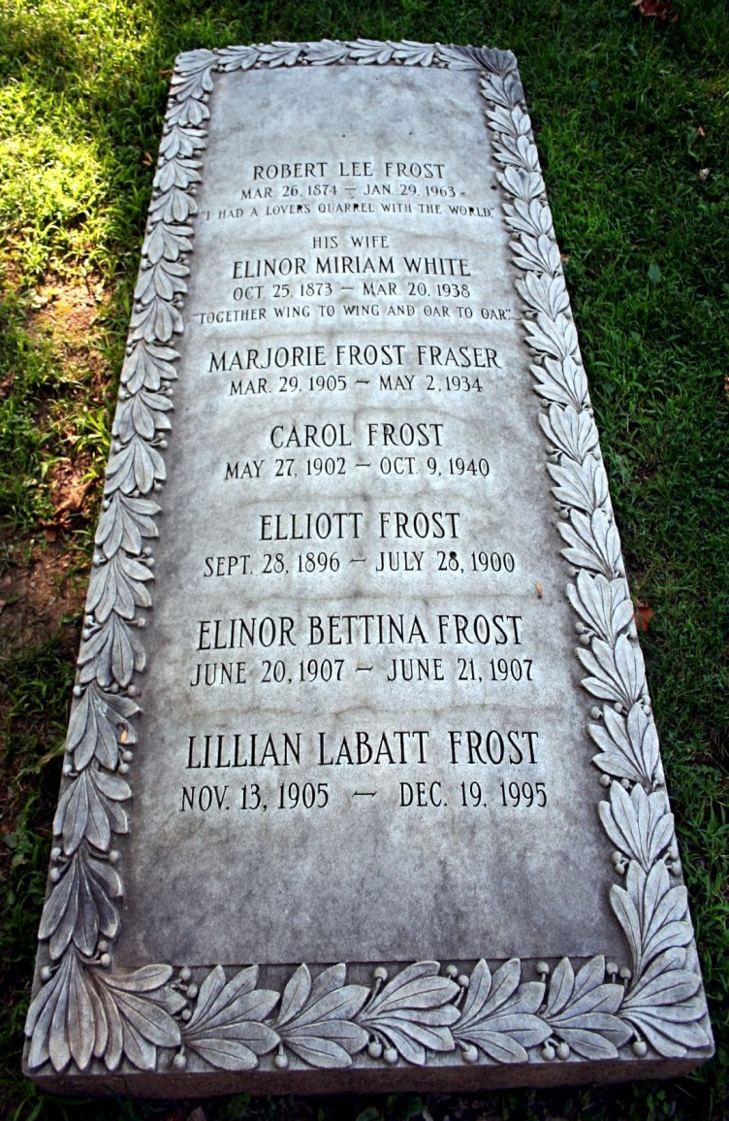
Death and Legacy
Died in 1963
People around the world mourned
“There ought to be in everything you write some sign that you come from almost anywhere.”

